Slide 1
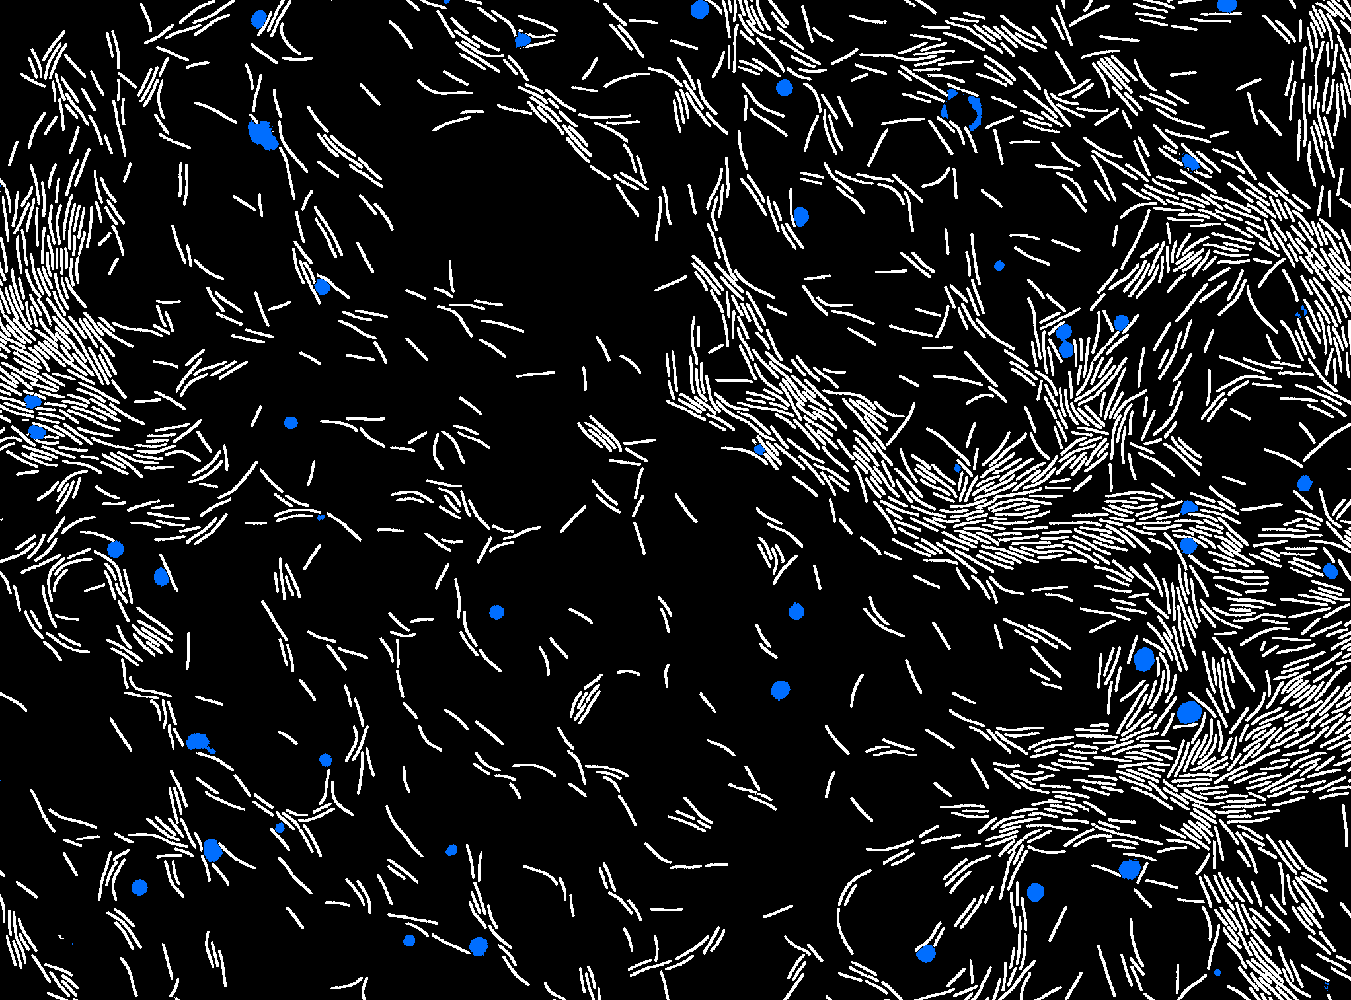
Deep Learning for beginners
Part II - ConvNet
JB Fiche, CBS-Montpellier & Plateforme MARS-MRI
Francesco Pedaci, CBS-Montpellier
Volker Bäcker, CRBM & MRI
Cédric Hassen-Khodja, CRBM & MRI

Slide 2
Outline
Introduction
Starting with Deep Learning and Artificial Neuron Network
Deep Learning for image analysis
Introduction to convolutional network
Application : Digit recognition
Practical case 1 : image classification
Practical case 2 : 2D regression of bead positions
Practical case 3 : Semantic segmentation of bacteria

Slide 3
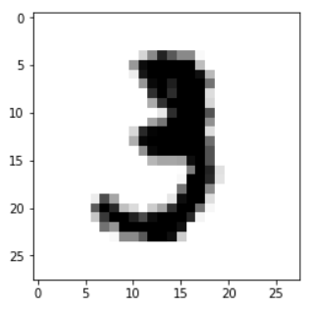
Analyze images with densely connected networks
Pixel #1
Pixel #2
Pixel #3
Number of parameters:
784*10+10 = 7850
784 inputs
…
28x28 pixels image
Pixel #n
First layer 10 neurons

Slide 4
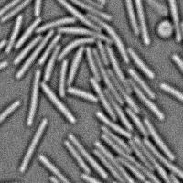
Analyze images with densely connected networks
Pixel #1
Pixel #2
Pixel #3
Number of parameters:
40,000*10+10 = 400,010 (!!!)
40,000 inputs
…
200x200 pixels image
Pixel #n
First layer 10 neurons

Slide 5
Analyze images with densely connected networks
Densely connected networks are not suited for image analysis:
Too many parameters, even for small networks
Loses the local information around each pixel
Go local
Learn local representations with convolutional network.

Slide 6
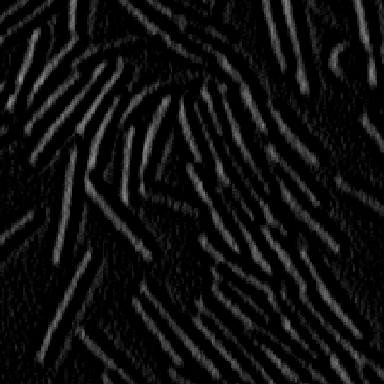

Convolutional neural network
⊗
Convolution
3x3

Slide 7
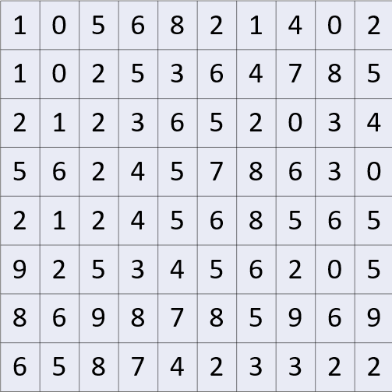
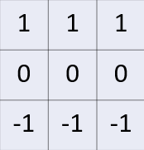
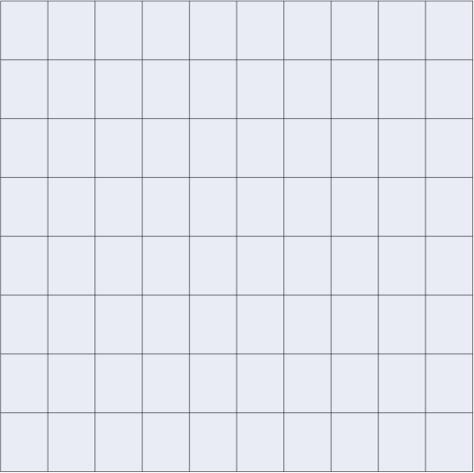
Convolutional operation …
2 x 1
+ 5 x 1
+ 3 x 1
+ 2 x 0
+ 3 x 0
+ 6 x 0
+ 2 x -1
+ 4 x -1
+ 5 x -1
= -1
Input image
Filter or kernel
-1
Convoluted image

Slide 8
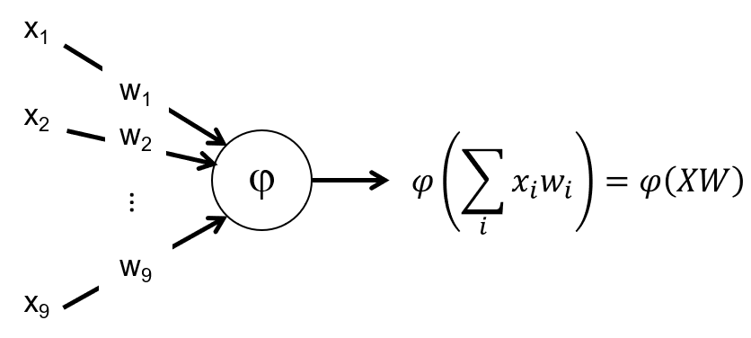
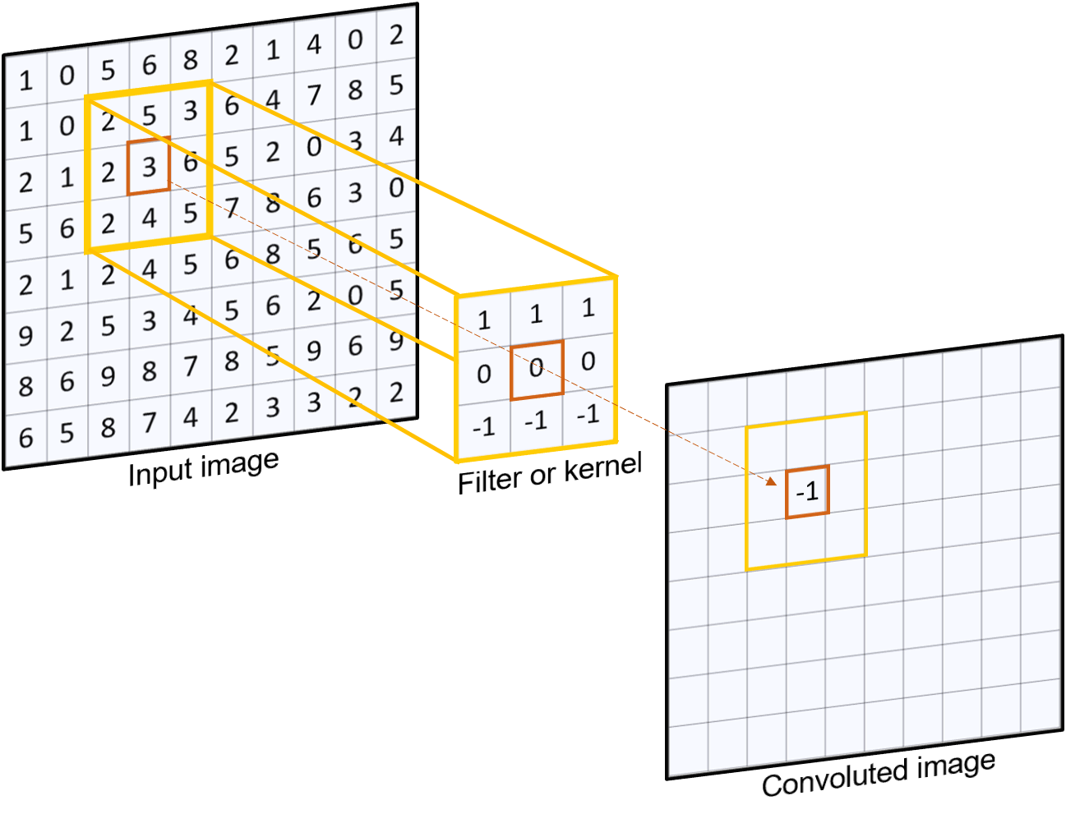
Convolutional operation and single neuron operation
In a convolution neural network, each set of weights associated to a neuron is equivalent to a filter.

Slide 9

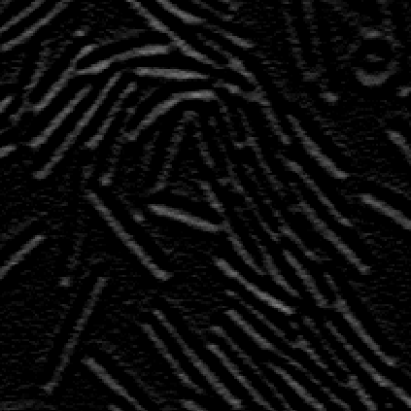
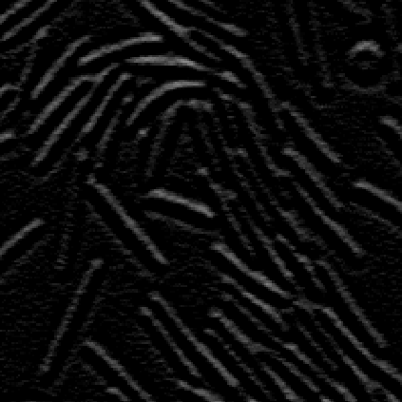
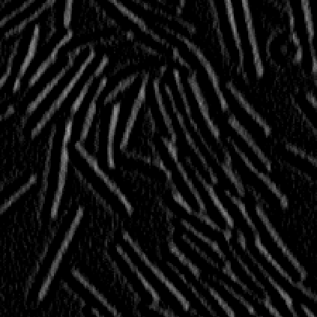
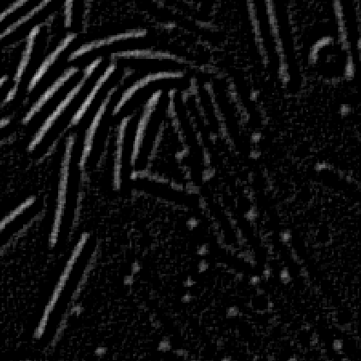

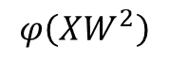
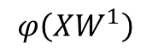
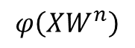
Convolutional neural network
Each filters will help highlights specific & useful features of the image (edge orientation, poles, texture, etc.)
$$φ\left(XW^{1}\right)$$
$$φ\left(XW^{2}\right)$$
⊗
Convolution
& ReLu
Features map
$$φ\left(XW^{n}\right)$$

Slide 10
Convolutional neural network
Input image
Feature map
convNet filter
Feature maps
There will be as many maps as neurons in the convolution layer

Slide 11
Convolutional neural network
Input image
Feature map
convNet filter
Pooling
Feature maps
There will be as many maps as neurons in the convolution layer

Slide 12
Goal of the max-pooling layer ?
1 | 4 | 5 | 2
0 | 1 | 6 | 2
7 | 0 | 0 | 4
1 | 5 | 2 | 2
Max pooling
2x2
4 | 6
7 | 4
⊗
=
200 x 200 pixels
200 x 200 pixels
100 x 100 pixels

Slide 13
Goal of the max-pooling layer ?
Reduce the spatial resolution of the feature maps while keeping only the most relevant information
Lowering memory and computing requirements
Create translation invariance
⊗
=
200 x 200 pixels
200 x 200 pixels
100 x 100 pixels

Slide 14
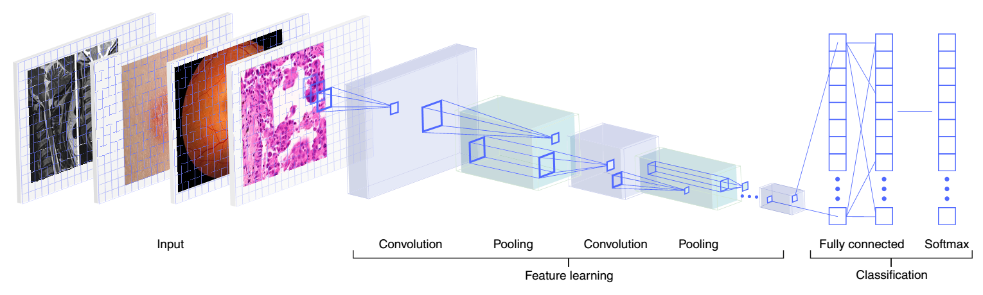
Convolutional network architecture
Classifier based on convNet are always built the same way:
A first part of the network is using convolution layers to learn the features
Convolution layers → features extraction
Pooling → downsampling
A second part is then classifying those features using densely connected layers in order to predict the right output.
Lots or parameters → heavy on the memory
Image input size is fixed → not flexible
Pic credit : Esteva et al. – 2019. Nature Medecine

Slide 15
Outline
Introduction
Starting with Deep Learning and Artificial Neuron Network
Deep Learning for image analysis
Introduction to convolutional network
Application : Digit recognition
Practical case 1 : image classification
Practical case 2 : 2D regression of bead positions
Practical case 3 : Semantic segmentation of bacteria

Slide 16

Classify hand-written digits
Example n°1 : MNIST_convNet
Understand and build your own ConvNet
Test this architecture for image classification

Slide 17
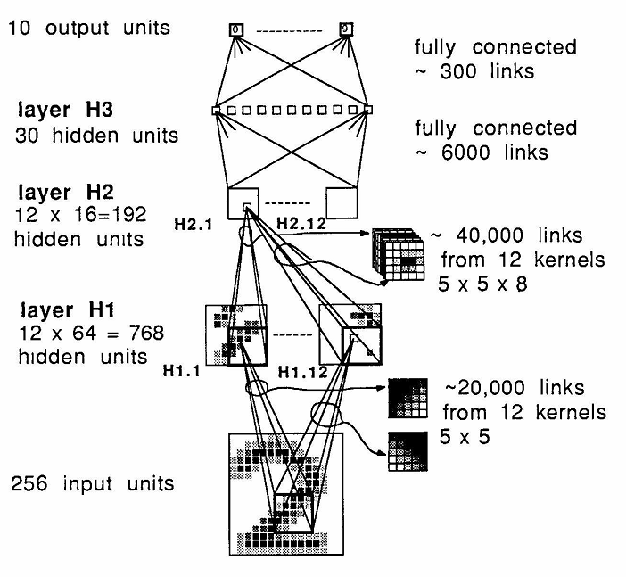
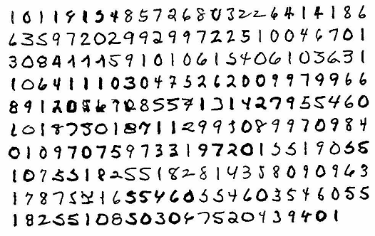
Hand-written zipcode classification - 1989
Densely connectected layers
Convolution layer
Pic Credit: LeCun et al. 1989. Neural Computation

Slide 18
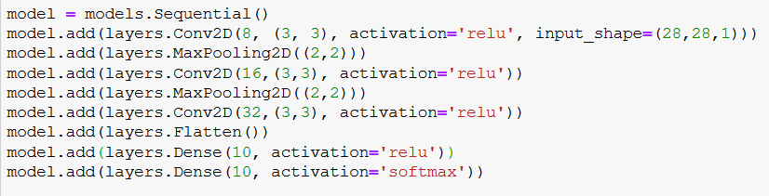
Hand-written digit classification with a ConvNet
Number of neurons/filters
Activation function
Filter size
Image size
# of output classes
Activation function for multiclass classification

Slide 19
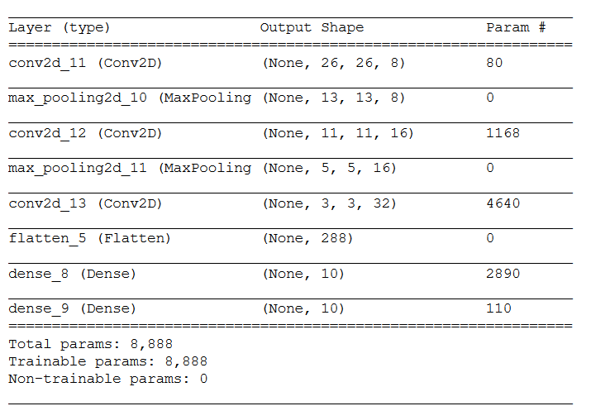
Hand-written digit classification with a ConvNet
>30% of the parameters

Slide 20
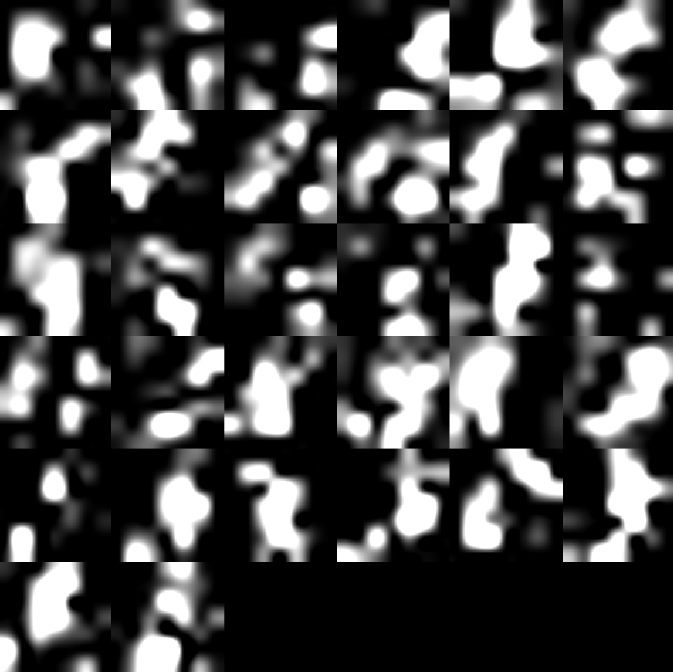
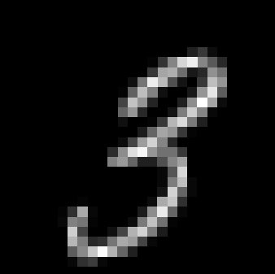
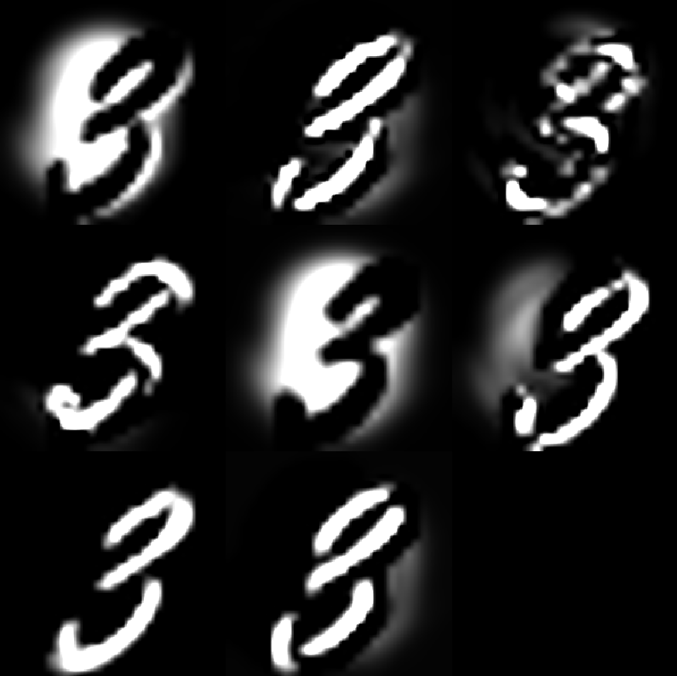
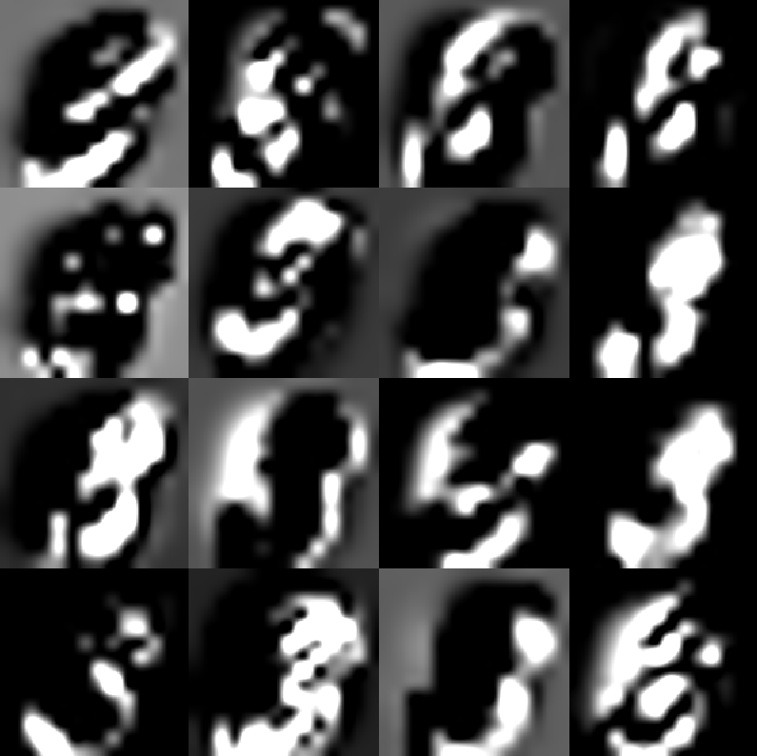
What are the features?
0
0
0
1
0
0
0
0
0
0
Layer 1
Layer 3
Layer 2

Slide 21
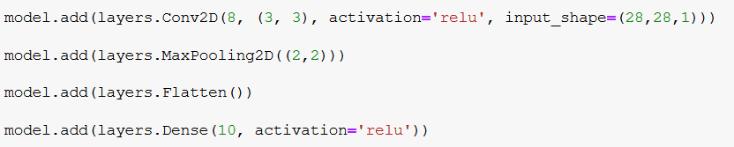
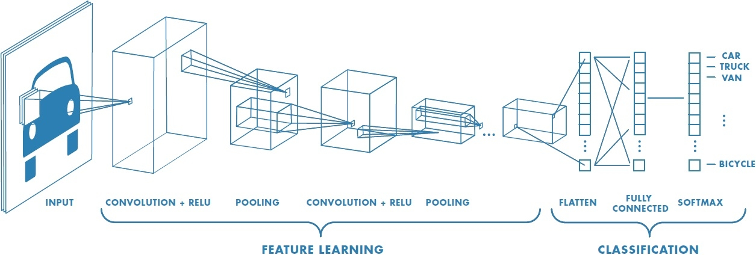
What did we learn?
How to build & train a simple classifier based on a convNet

Slide 22
Outline
Introduction
Starting with Deep Learning and Artificial Neuron Network
Deep Learning for image analysis
Introduction to convolutional network
Application : Digit recognition
Practical case 1 : image classification
Practical case 2 : 2D regression of bead positions
Practical case 3 : Semantic segmentation of bacteria

Slide 23
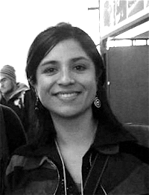


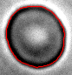
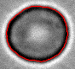
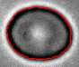
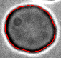
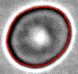
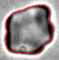
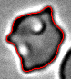
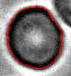
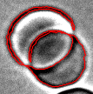

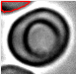
Deep Learning applied to image classification
Viviana Claveria
Manouk Abkarian
Good images
In-focus image of RBC with a properly defined contour (red)
Bad images
Poor quality images that need to be discarded from the analysis
Sick cells
Out-of-focus
Overlapping
Failed contour

Slide 24
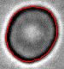
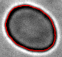
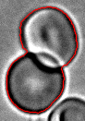
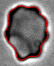
Classify red blood cell (RBC) images
Example n°2 : RBC_image_classification_no_image_augmentation
Build your own ConvNet classifier to solve a biological problem
Understand how to detect overfitting and which strategies to avoid it
How already-trained network can be used for classification

Slide 25
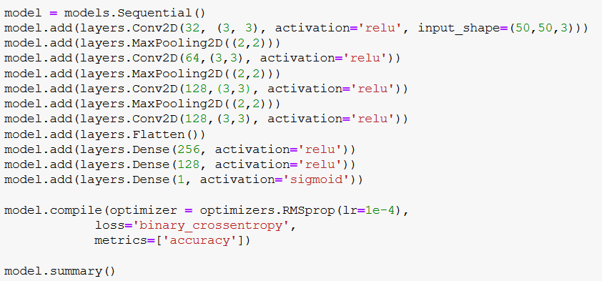

One possible solution …
Type of data : png RGB images resize to 50x50 and normalized
Size of the training set : 956 good images / 2000 bad images
Size of the validation/testing sets : 319 good images / 667 bad images
Number of trainable parameters : 405,185

Slide 26
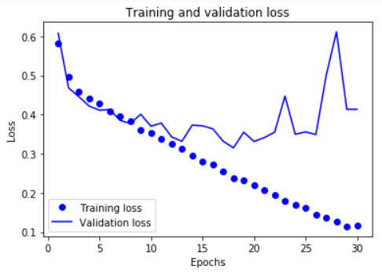
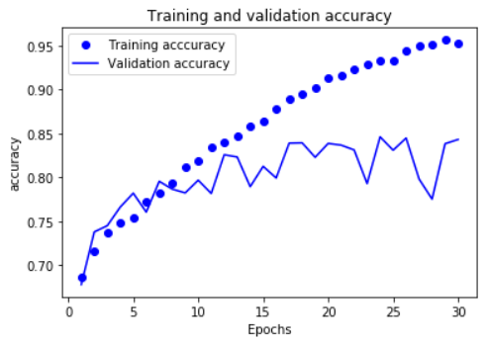
… but overfitting
Using the validation set, we observe that the training and validation loss & accuracy are diverging after epoch #12. The network is no longer learning new useful features.
Overfitting
Validation loss & accuracy are noisy
The global accuracy of the network is ~84%

Slide 27
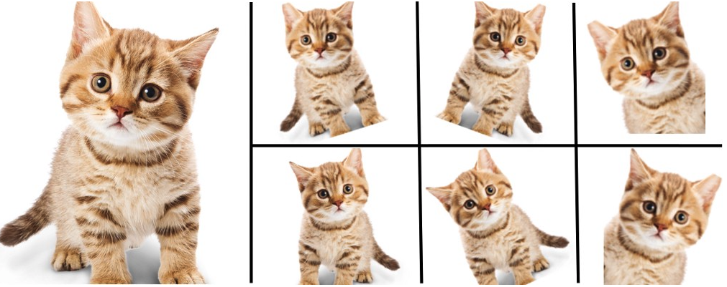
How to avoid overfitting?
Reduce the size of the network … but no magical formula to determine how many layers we need
Increase the size of the training set:
Actually increase the number of images
Use image augmentation strategy

Slide 28
How to avoid overfitting?
Reduce the size of the network … but no magical formula to determine how many layers we need
Increase the size of the training set:
Actually increase the number of images
Use image augmentation strategy
Dropout, randomly “turning-off” neurons of the network
Dropout is used to avoid co-adaptation of neurons → enforce the fact that neurons should learn and work independently.
No dropout
Dropout with 40% probability

Slide 29
How to avoid overfitting?
Reduce the size of the network … but no magical formula to determine how many layers we need
Increase the size of the training set:
Actually increase the number of images
Use image augmentation strategy
Dropout, randomly “turning-off” neurons of the network
Weight regularization L₁ & L₂, a strategy to force the weights to take only small values during the training:
L₁ – the cost added to the loss is proportional to the absolute weight value
L₂ – the cost is proportional to the square value of the weight

Slide 30
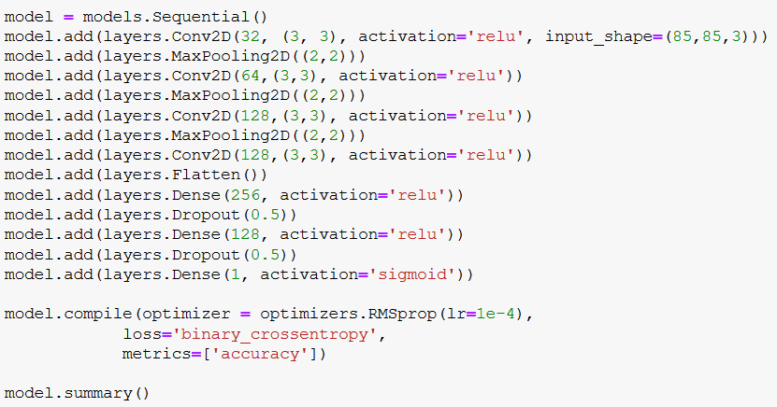
Effect of image augmentation & dropout
Type of data : png RGB images resize to 85x85 and normalized
Size of the training set : 956 good images / 2000 bad images
Size of the validation/testing sets : 319 good images / 667 bad images
Number of trainable parameters : 1,453,761

Slide 31
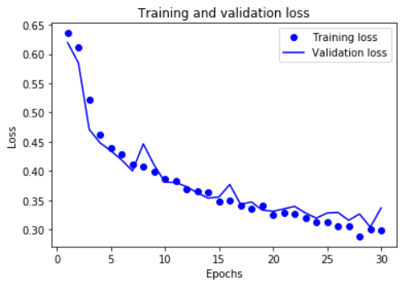
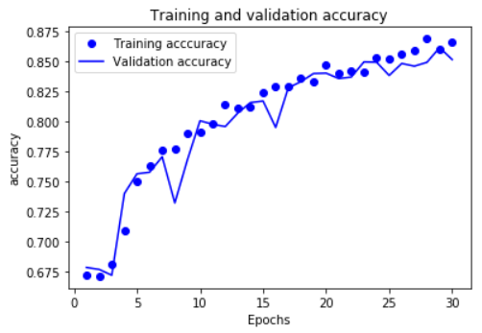
Better but the accuracy is still <90%
Basic convNet
ConvNet with image augmentation & dropout

Slide 32
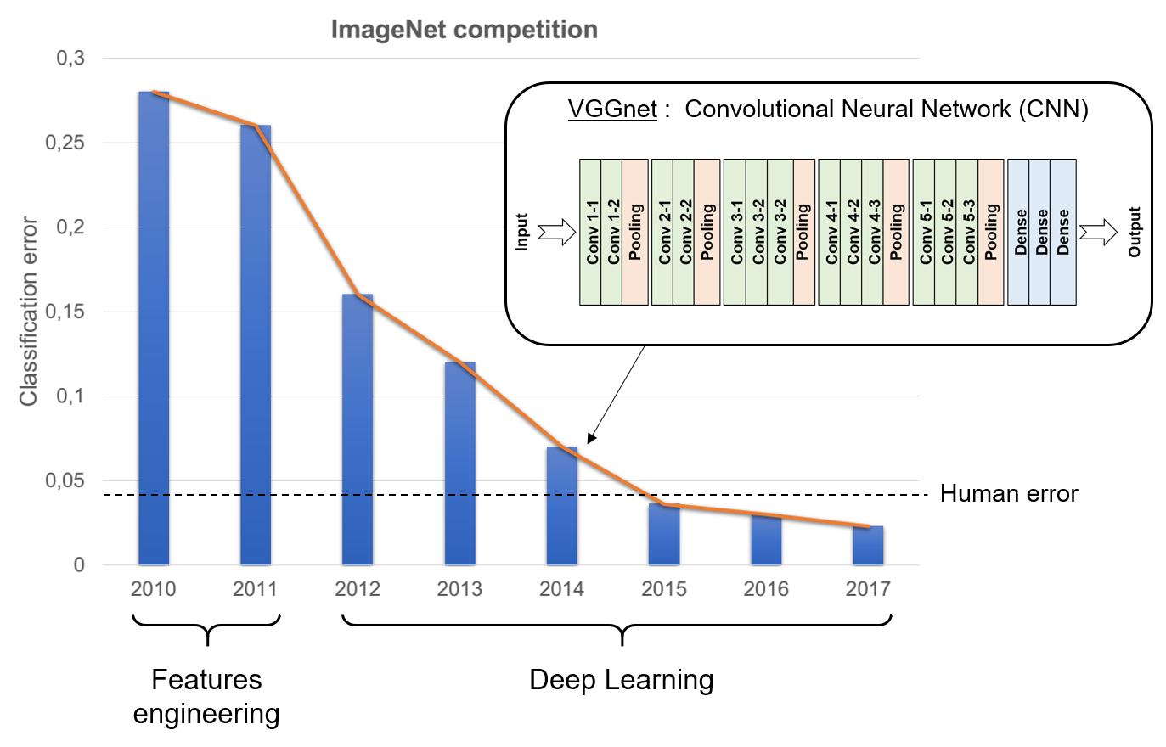

Used a pre-trained convNet
Many networks used for the Image Large Scale Visual Recognition Challenge are available and already trained on million of images.
https://keras.io/applications/
138,357,544
Notes:
138M of parameters

Slide 33



Used a pre-trained convNet : VGG16
Already trained
14,714,688 fixed parameters
Remove the dense layers
Add new dense layers with the right output
To train to adapt to the new problem
1,213,441 trainable parameters

Slide 34


Used a pre-trained convNet : VGG16

Slide 35


Fine tuning pre-trained network : efficient strategy!
Basic convNet
Fine-tune a pre-trained network

Slide 36


Used a pre-trained convNet : VGG16
Already trained
Remove the dense layers
& the last convolution block
Add new dense and convolution layers with the right output
To train to adapt to the new problem

Slide 37
What did we learn?
Step 1 : Clarify your problem and assemble a dataset for the training
Step 2 : Try a simple architecture (for example MNIST) and test it
Your problem can be solved using DL?
Training data format OK
Measure of success
etc.
Step 3 : Scale up the model until you observe overfitting
Step 4 : Improve your model performances

Slide 38
Outline
Introduction
Starting with Deep Learning and Artificial Neuron Network
Deep Learning for image analysis
Introduction to convolutional network
Application : Digit recognition
Practical case 1 : image classification
Practical case 2 : 2D regression of bead positions
Practical case 3 : Semantic segmentation of bacteria

Slide 39






A practical application of Deep Learning for regression
Tracking microscopic beads rotated by the flagellar motor of a bacteria
Francesco Pedaci
Ashley Nord
50 nm

Slide 40
Outline
Introduction
Starting with Deep Learning and Artificial Neuron Network
Deep Learning for image analysis
Introduction to convolutional network
Application : Digit recognition
Practical case 1 : image classification
Practical case 2 : 2D regression of bead positions
Practical case 3 : Semantic segmentation of bacteria

Slide 41





Deep Learning applied to semantic segmentation
Sara Rombouts
Marcelo Nöllmann
JB Fiche
Segmentation
Bright field image of Myxococcus xanthus cells on an agard pad

Slide 42
ConvNet applied to cell segmentation
Cell boundary
Cell interior
Background
convNet
31x31
31x31px
32x32px
544 weights
16x16px
18,496 weights
8x8px
304,456 weights
FC
2,561,000 weights
Input layer
Convultional layer
ReLU layer
MaxPooling layer
Fully connected layer + softMAX
32 filters
4x4
64 filters
3x3
128
3x3
200
3x3
Van Valen et al. 2016. Plos Computational Biology
Notes:
Semantic neural network
42

Slide 43



Main drawback of convNet : the speed
2048x2048 pixels
Cell boundary
Cell interior
Background
convNet
classification
31x31
>4M
~15 minutes to segment a single image
>500
~5 days to analyze an experiment…

Slide 44

Fully convolutional neural network : FCNN - SegNet
This type of neural network architecture has many advantages:
Simple to implement
Faster
Less heavy on memory since no fully connected layers
No restriction on the size of the input images
The output image is already segmented
Badrinarayanan et al. IEEE 2016 – Noh et al. ArXiv 2015 – Ronnerberger et al. ArXiv 2015

Slide 45

Fully convolutional neural network : FCNN - UNet
Badrinarayanan et al. IEEE 2016 – Noh et al. ArXiv 2015 – Ronnerberger et al. ArXiv 2015

Slide 46
Petit UNet …
Input raw image(s)
Convultional layer
ReLU layer + batch normalization
Total number of learnable : 1,864,969
MaxPooling layer
Deconvolution layer
Output segmented image
64 filters
3x3
128 filters
3x3
256
3x3
128 filters
3x3
64 filters
3x3
Data from convolution block 2
Data from convolution block 1

Slide 47


… mais costaud !
2048x2048 pixels
UNet
~4s

Slide 48





How to evaluate the quality of the prediction?
Ground truth
Accuracy for each class:
False negative
$$\frac{TP}{TP+FN}$$
True positive
Cell : 87%
Contour : 92%
Original image
False positive
Good results even if the accuracy is <90%
Model prediction

Slide 49

How to evaluate the quality of the prediction?
Ground truth
False negative
IoU or Jaccard similarity:
True positive
$$\frac{TP}{TP+FN+FP}$$
Original image
False positive
Cell : 85%
Contour : 90%
Model prediction

Slide 50


One last VERY important point
Your images should be normalized:
Average intensity equals to 0
Standard deviation equals to 1
Your set of images should be as representative and diverse as possible
M.Xanthus + E.coli
E.coli
Segmentation
M.xanthus

Slide 51





One last VERY important point
Your images should be normalized:
Average intensity equals to 0
Standard deviation equals to 1
Your set of images should be as representative and diverse as possible
Variation in :
Density of cells
Different focal planes
Light intensity
etc.
Good generalization!

Slide 52

Outline
Introduction
Starting with Deep Learning and Artificial Neuron Network
Deep Learning for image analysis
Conclusion…

Slide 53
Activation Function
generalization
overfitting
gradient descent
ground truth
hyperparameter
matplotlib
neuron
one-hot encoding
learning rate
Backpropagation
Categorical Cross-Entropy
CNN, ConvNet
Dropout
Keras
Max-Pooling
MNIST
Momentum
Nonlinearity
ReLU
SGD
Softmax
TensorFlow
Vanishing Gradient Problem
VGG16
data augmentation
transfer learning
epoch
weights
bias
hidden layer
batch size
classification
regression
convolution
loss function
testing set
validation set
training set
deep
optimizer
fully connected layer

Slide 54


Bibliography & useful links
F. Chollet – 2018 – Deep Learning with Python
P. Kim – 2017 – Matlab Deep Learning
I. Goodfellow, Y. Bengio, A. Courville – 2016 – Deep Learning
Stanford lectures on Deep Learning and Machine Learning : https://cs230.stanford.edu/lecture/
Inaugural lecture of Y. Lecun at collège de France : https://www.college-de-france.fr/site/yann-lecun/inaugural-lecture-2016-02-04-18h00.htm
Awesome website for math : https://www.3blue1brown.com/

